Slide 1
Headwinds for the Australian Economy and Financial System
David Llewellyn-Smith
Leith van Onselen

Slide 2
Overview of Australian housing market
After 23 years without a technical recession, Australia finds itself at a critical juncture.
With its economy ‘hollowed-out’ and broadly uncompetitive, Australia is facing stiff headwinds from multiple forces, which threatens to raise unemployment, reduce incomes, and ultimately lower standards of living.
These risks are made worse by Australia’s near record household debt and a housing market that is commonly regarded as one of the world’s most over-valued.
How events play-out will largely hinge on the fortunes of our biggest export market, China.

Slide 3
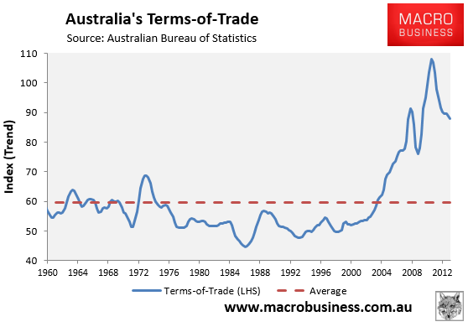
The key beneficiary of the China boom
China’s rapid rise, and insatiable appetite for commodities, led to the biggest boom in commodity prices and the terms-of-trade in Australia’s history.

Slide 4
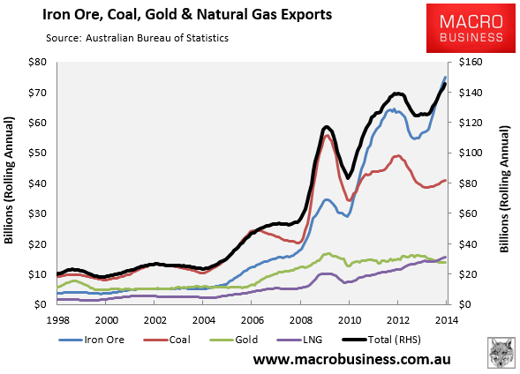
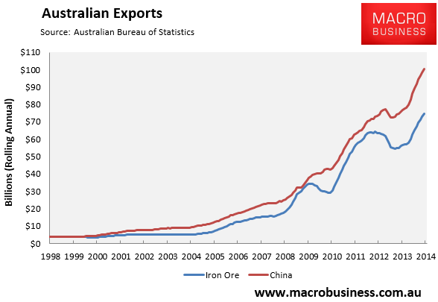
Commodity exports boomed
Australian commodity exports have soared since 2003 on the back of China.
Iron ore, in particular, has been the biggest winner.

Slide 5
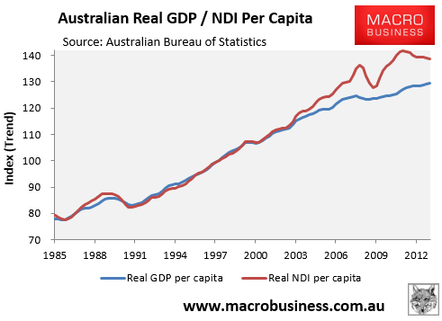
National income surged
Strongly rising commodity prices from 2003 meant that national income grew at a much faster rate than output (GDP).
This made Australians richer, since we could buy more imports from a given volume of exports.

Slide 6
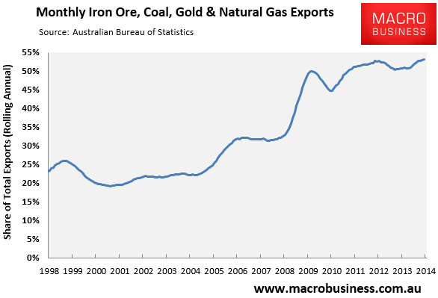
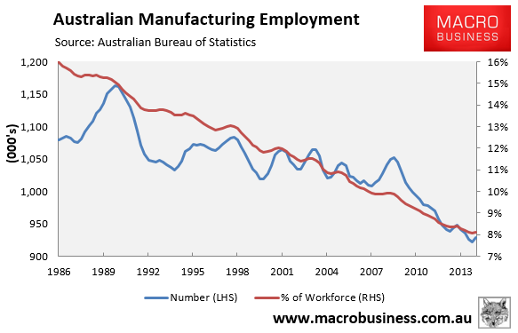
Dark side of the boom
But Australia’s non-mining economy has been crowded-out, narrowing our economic base.
The manufacturing industry, in particular, has suffered immensely and Australia’s economy now lacks diversification.

Slide 7
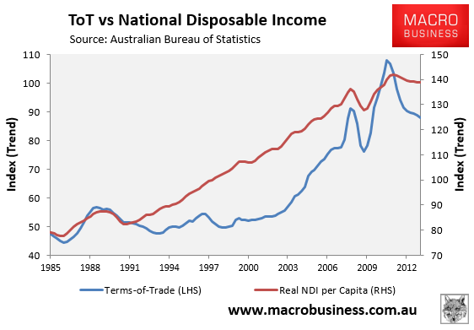
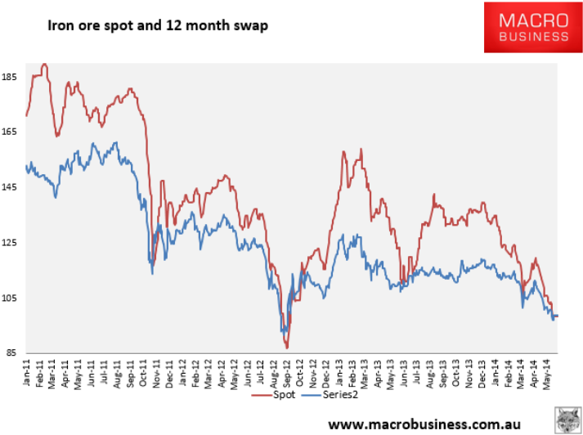
Our luck is running out
swap
Commodity prices peaked in 2011 and are now falling, dragging-down the terms-of-trade and national disposable income.
If falls persist, which we believe they will, incomes will grow at a much slower rate than GDP going forward.

Slide 8
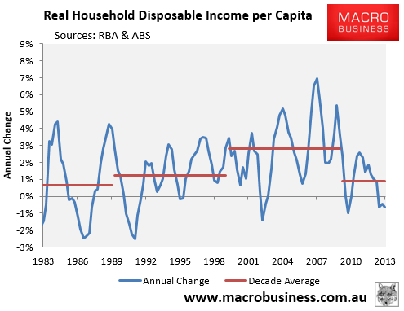
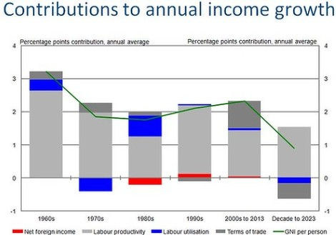
An income shock in the making
Per capita household income growth is slowing fast. In the 2000s, incomes grew on average by 2.8% p.a. So far this century, growth has slowed to just 0.9% p.a.
Australian Treasury forecasts that average per capita income growth would halve over the next decade to the lowest rate of growth experienced in at least 50 years, weighed down by the falling terms-of-trade.

Slide 9
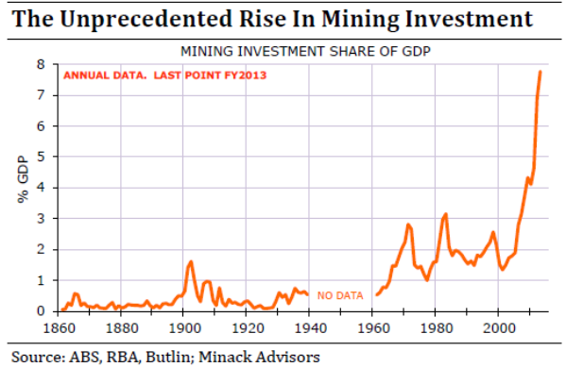
An employment shock is also in the making
Australia’s economy has been supported by the biggest mining investment boom in the nation’s history.
According to the RBA, around 10% of employment is in the mining sector, with most employed in areas directly related to capital investment.

Slide 10
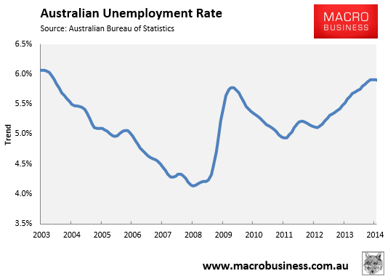
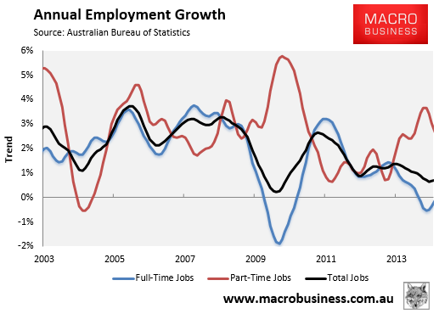
An employment shock is also in the making
Despite the record growth in mining capex, Australia’s employment market is soft. The unemployment rate is already at decade highs, whereas full-time jobs have been shed over the past year.

Slide 11
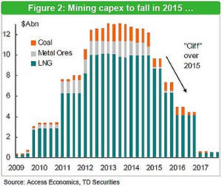
An employment shock is also in the making
Most forecasters expect large falls in mining capex from 2015.
This will weigh heavily on employment, particularly construction workers, engineers, and other mining services .
NAB forecasts 100k job losses next year alone.
The shuttering of the local car industry by 2017 places at risk another 50,000 jobs, accentuating these pressures.

Slide 12
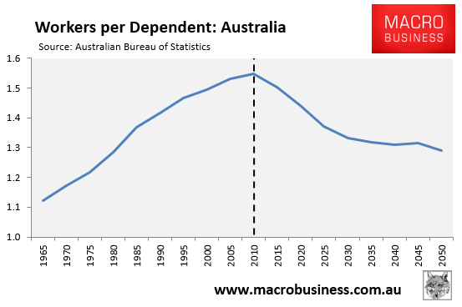
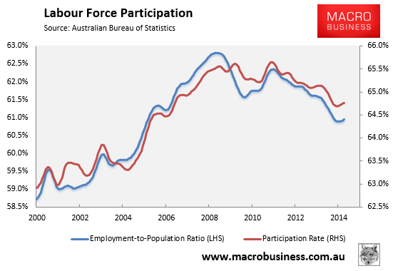
Demographic headwinds are building
The large scale retirement of the baby boomer generation will reduce the proportion of workers in the economy, reducing the economy’s growth potential, lowering national income growth, and lowering demand for assets (particularly housing).

Slide 13
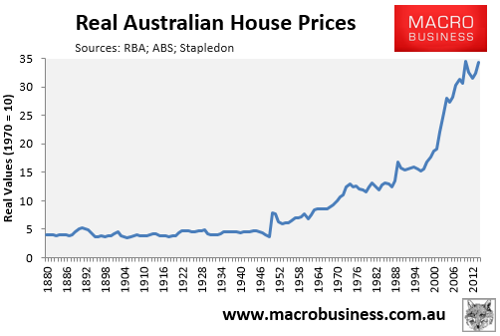
Overview of Australian housing market
House prices in Australia have experienced a prolonged period of exceptionally strong growth.
Real prices increased by 120% between 1996 and 2010.
We are again approaching these levels.

Slide 14
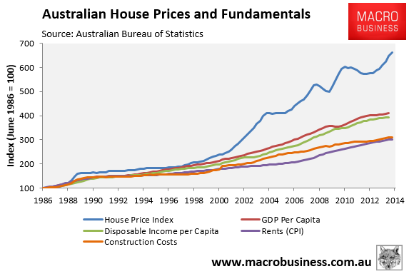
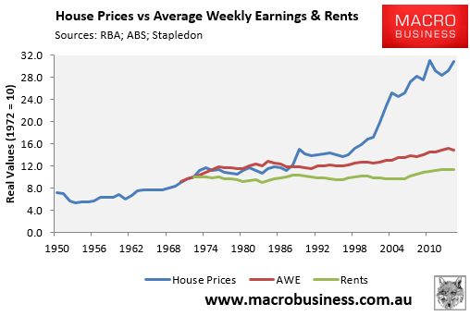
Overview of Australian housing market
Growth was not met by underlying fundamentals.

Slide 15
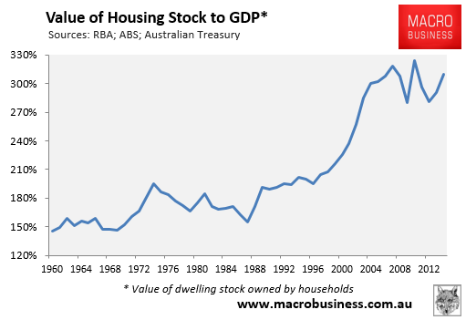
Overview of Australian housing market
Value of housing stock relative to GDP also far above historical norms and approaching 2010’s high.

Slide 16
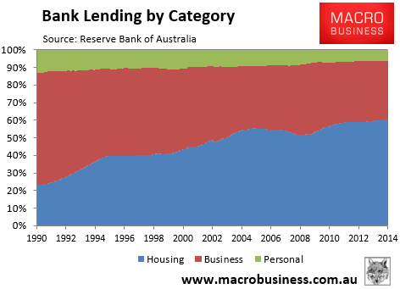
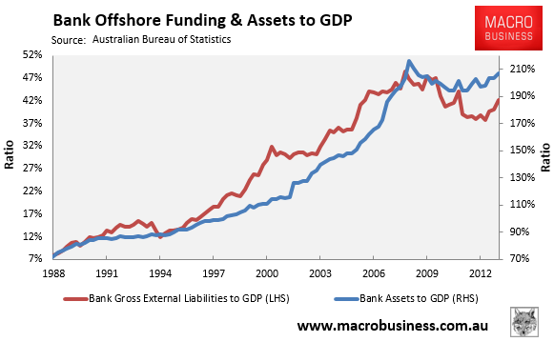
Banking system too housing focused
Share of loans into housing increased from 24% of total loans in 1990 to 60% currently. Business loans fallen from 64% to 33% over same period.
The rapid expansion of mortgage debt and housing values has been funded, to a large extent, by heavy offshore borrowings by Australia’s banks and is represented by a massive expansion in bank assets (mainly mortgages) relative to GDP.

Slide 17
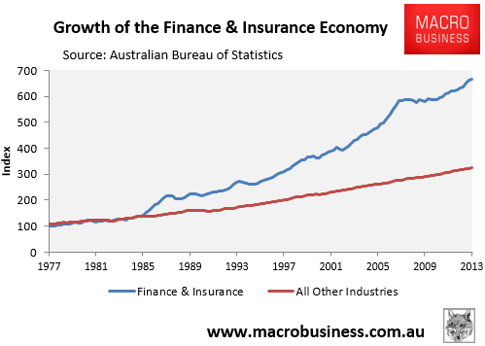
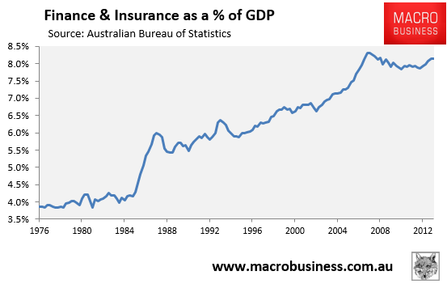
Housing choking-off other sectors
The Finance & Insurance industries have grown more than twice as fast as the rest of the economy since the mid-1980s, when financial markets were deregulated.
Finance & Insurance’s share of GDP has more than doubled to over 8%.

Slide 18
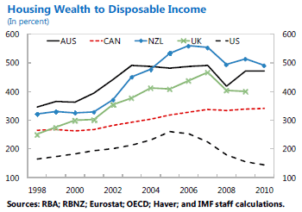
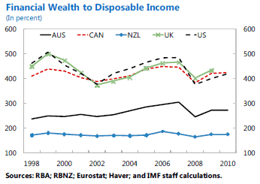
Too much wealth tied-up in housing
Aussies hold a disproportionate share of their wealth in housing, compared with other English-speaking nations.

Slide 19
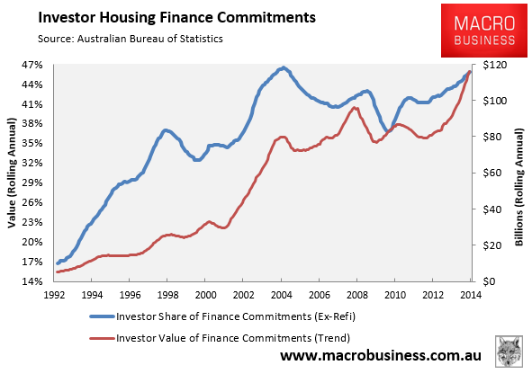
Current situation unsustainable
With Aussie home prices growing at four times the pace of wages over past year, values will soon hit the highest level on record against incomes, CPI and GDP.
Growth is unsustainable, driven almost entirely by rabid investor demand.

Slide 20
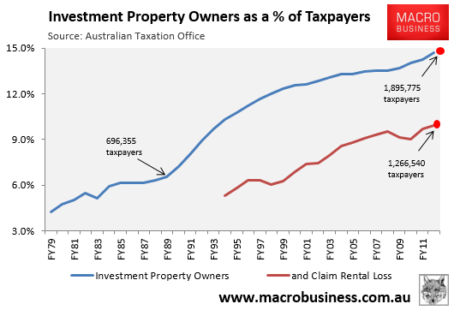
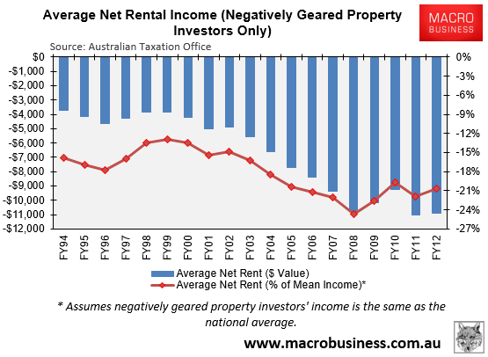
A nation of loss-making landlords
The number of property investors has surged, from 696,355 in 1990 to 1.90 million in 2012.
Two-thirds (1.27 million) of investors were negatively geared in 2012, losing on average $10,895 per year. 70% of negatively geared investors earned less than $80,000.

Slide 21
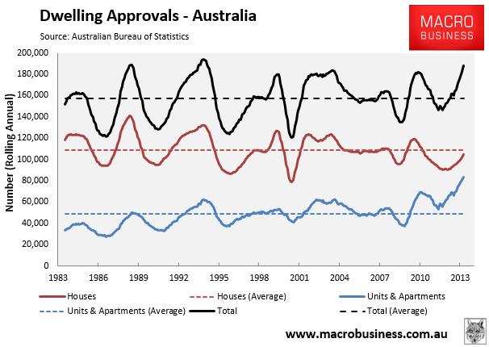
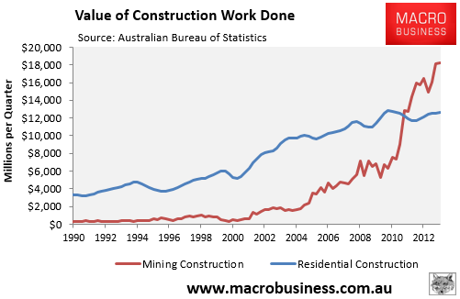
Housing won’t fill the void
RBA has been intent to let housing run in the hope that construction can fill the void left as mining capex unwinds.
But how realistic is this? Mining construction is currently around 50% bigger than housing, and will likely fall much quicker and by a much larger amount than housing construction could ever hope to grow.

Slide 22
Australia left facing a dangerous conundrum
Australia is at a dangerous inflection point.
The rivers of gold from the once-in-a-century mining boom, along with the shuttering of the local car industry, will likely create a shock to incomes and employment that could last a decade.
Meanwhile, Australian housing values are accelerating into trouble and will soon hit their highest valuation ever, driven by an unsustainable surge in investor demand.
Nobody knows how badly the situation will play out. However, the risk of a substantial housing correction sometime in the near future is arguably greater now than at any other time in living memory.
This has obvious implications for bank profitability and capital, along with financial system stability.

Slide 23
How bad could it get?
With a bit of luck, Australia will muddle through and experience a prolonged period of anaemic income growth, steadily rising unemployment (to say 7%), and a small housing correction followed by sluggish growth.
But there is the risk that things could get much worse if China slows faster than expected and/or there is dislocation in financial markets.
China’s property market, in particular, is looking increasingly unstable, which could lead to a significant fall in steel demand, adversely impacting Australian iron ore and the broader economy.

Slide 24
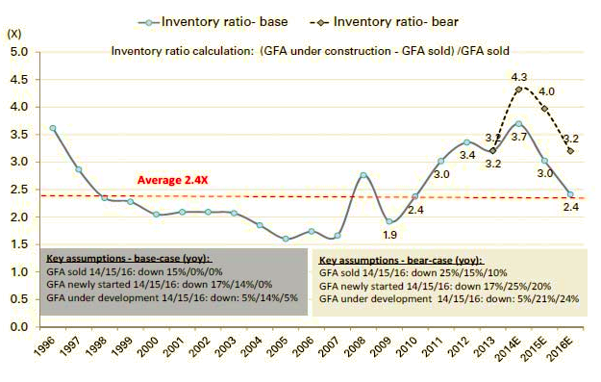
The Chinese property shakeout
Residential construction represented roughly one quarter of China’s 20% fixed asset investment (FAI) growth in 2013.
GS forecasts 5% (2014) and 14% (2015) falls in construction floor space.
Could wipe 5-6% off FAI growth across the two years.
FAI is already at 17%, so we’re talking about a fall to 11-12% year on year growth (on the back of an envelope).
This is consistent with a swift rebalancing of Chinese growth and a probable fall to about 6% GDP growth if spill overs are contained (which is questionable).

Slide 25
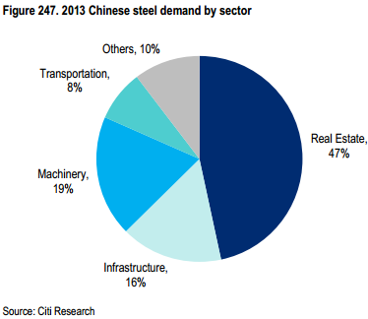
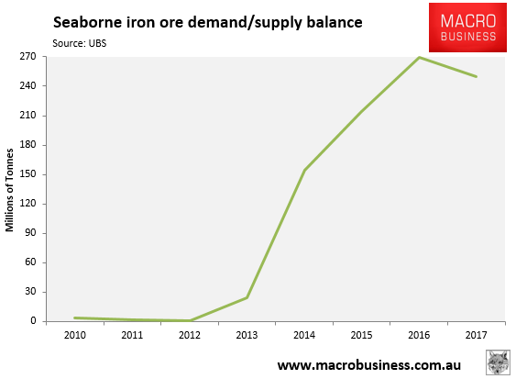
Impact on commodity prices
FAI is the most steel intensive component of Chinese growth, roughly three times more so than services, and real estate absorbs up to half of steel output.
Iron ore is already entering structural over supply on aggressive Pilbara expansions.
Iron ore price will likely fall to $80 or below for an extended period.

Slide 26
Possible impacts on Australia
Every $3 fall in the iron ore price knocks around 1% off the term-of-trade.
The latest Budget forecast for the terms-of-trade is for a fall of 6.75% for 2014/15. If iron ore falls to $80, then the hit will be more like 10% and much sooner as well, which will knock a big hole in revenue forecasts and damage the public’s faith in budget repair. It will also crimp national income growth even further.
The same price level will send iron ore juniors (and possibly even one major) to the wall, rocking the stock market and investor confidence.
The income shock will be exacerbated by stalling volumes.
Given public austerity and weak consumer confidence, house prices could roll over as the labour market softens in the services economy, even as it is tumbling in mining and related sectors.

Slide 27
Possible impacts on Australia
The RBA can cut rates again, perhaps by another 75bps. But a few more rate cuts may not be enough to arrest this negative loop of falling house prices, sentiment and employment.
Fiscal stimulus is possible – perhaps around half the size of Rudd’s rescue - but with the ratings agencies warning that the Budget must aim for surplus across the cycle to support AAA rating, no more than that.
Stimulus could buy the economy some time, but given China’s bust will likely represent the tipping at which it goes “ex-growth”, commodity prices will likely continue to fall, keeping pressure on the Budget.
The AAA sovereign rating could be stripped and passed onto the banks via the implied guarantee. Bank funding costs would begin to rise despite a chronically weak economy and, given interest rates would be as low as they can go, housing could continue to fall.

Slide 28
Questions?

